Slide 1
ElectroRing Active electrical sensing
31/08/22
Fabio Bazzi
Notes:
Intro:
-Welcome all introduce myself -Imaging a world where you can just interact with a pinch of your fingers with your personal computer. I present to you the replica of electroring.

Slide 2
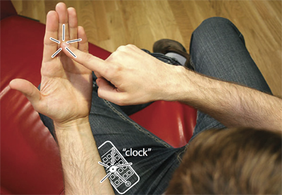
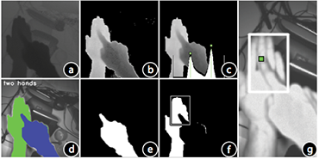
Motivation – Imaginary phone
Hand as imaginary phone
Depth image with time-of-flight camera
Imaginary Phone
Gustafson et al. UIST’ 11
Imaginary Phone
Gustafson et al. UIST’ 11
Source: https://www.chrisharrison.net/index.php/Research/OmniTouch
Notes:
If you are wondering how I changed the slide with just a pinch of my finger, then you are completely in the right place today. As a demo of my semester project I will use it throughout the presentation to switch the slides
Increased user mobility requires new ways to interact with computer beyond touchscreens, mice and keyboards.
last night paul drew my attention to a paper by sean gustafson that was written in collaboration with christian.
They introduced a promising paradigma in 2011 with the Imaginary phone, using a time of flight camera to turn the hand into a imaginary phone
With this technology any part of the body can be turned into a touch screen.
Nevertheless, the effectiveness of this approach hinges on the system’s ability to detect precisely when the user’s finger is in contact with the instrumented surface.
Unfortunaly, from a first persons camera view, it is difficult to tell whether a finger is touching or just hovering.

Slide 3
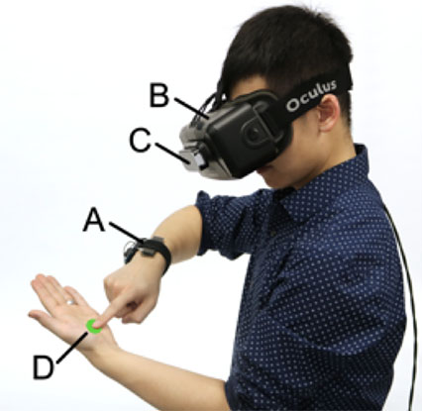
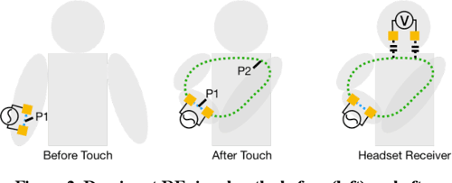


Prior work - ActiTouch
Active electrical sensing for robust touch detection
Subtle touch
High accuracy
Requires two points of instrumentalization
ActiTouch
Zhang et al. UIST’ 19
Notes:
ActiTouch, presented in 2019 from Zhang, is a nice solution to this problem.
It uses a wristband to couple an electrical signal to the user’s body. A receiver circuit is integrated into a VR headset.
When the users touches their opposite hand an electrical path is formed that changes the strength of the singal arriving at the headset
From this change in signal a touch event can be concluded. With the electrical approach, ActiTouch can detect very subtle touch gestures with a high accuracy.
The main drawback however, is that it requires two points of instrumentation A transmitter connected to the wrist and a receiver mounted to the headset.

Slide 4
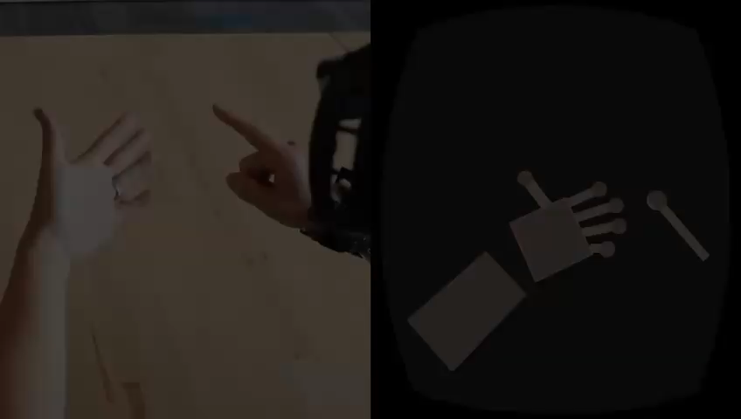
Prior work - ActiTouch
ActiTouch demo
https://www.youtube.com/watch?v=hrjjojs41H8
Notes:
Here you can see a short demo of ActiTouch
Pleas keep in mind that the finger tracking is done with the headset, where the only touch events are detected with the electrical active sensing

Slide 5
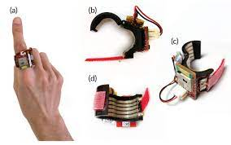
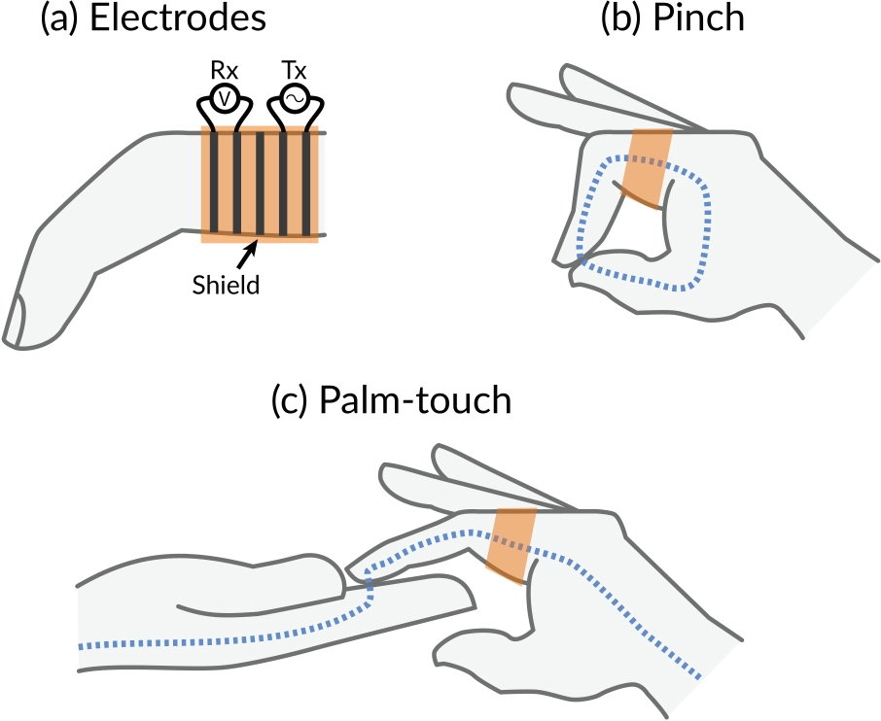
Prior work - ElectroRing
ElectroRing for robust touch detection
ElectroRing
Kienzle et al. CHI’ 21
Notes:
To overcome the issue of two points of instrumentalisation, Kienzle presented a neat soloutin in their work, namly Electroring
Electroring consist of the electric activ sensing system and an IMU
Electro ring solves the problem of the transmitter directly sending into the receiver, by seperating the receiver electrodes and the transmitter by an electrical shield
As you can see in the Figure on the right the path for touch detection can be closed by either pinching or touching the body at an arbitary place

Slide 6
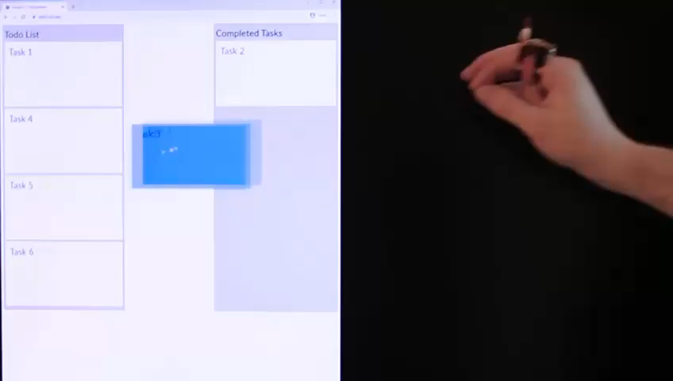
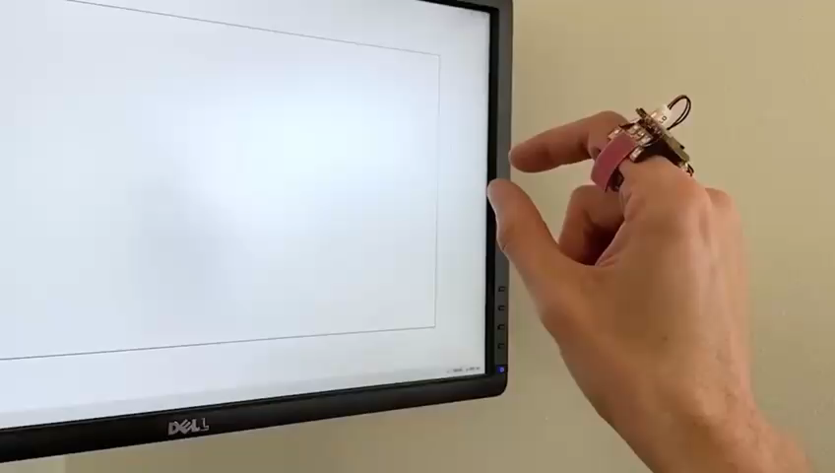
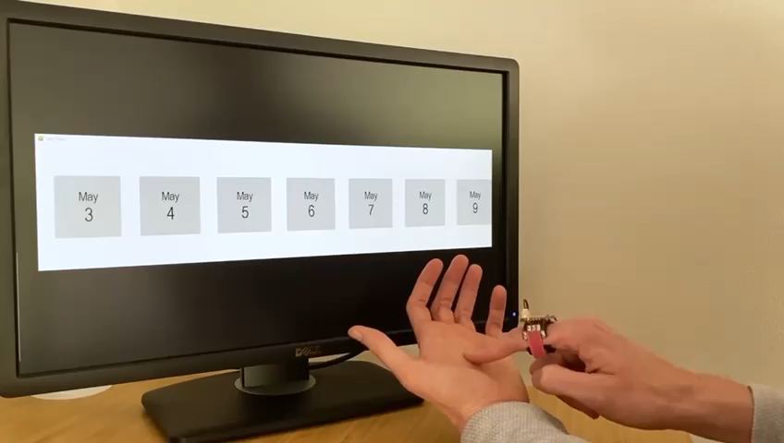
Prior work - ElectroRing
Application examples for ElectroRing
Source : https://www.youtube.com/watch?v=P5btfdamrq4
Notes:
Here you can see three different application examples of electroRing.
The video on the left shows how it can be used to drag and drop something
In the middle you see how it can be ussed to draw something
And on the rigth you can see how it can be used to scroll and stop
Please keep in minde that this is only possible with an integrated IMU, since the movement of the heand has to be estimated to controll the position of the coursor

Slide 7
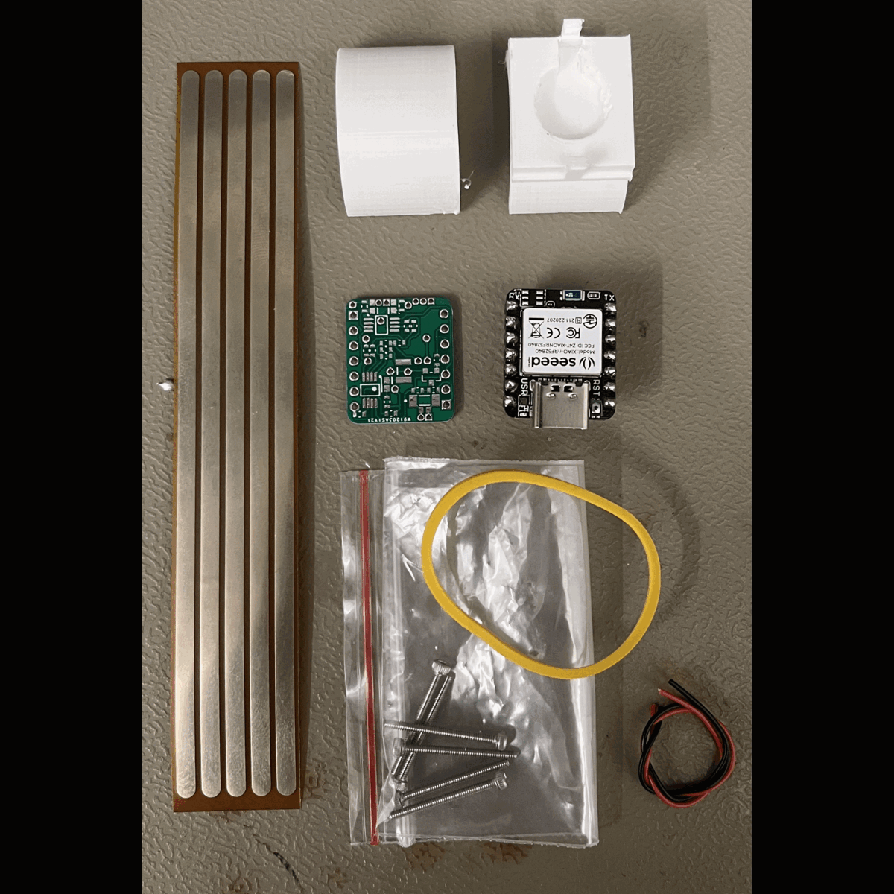
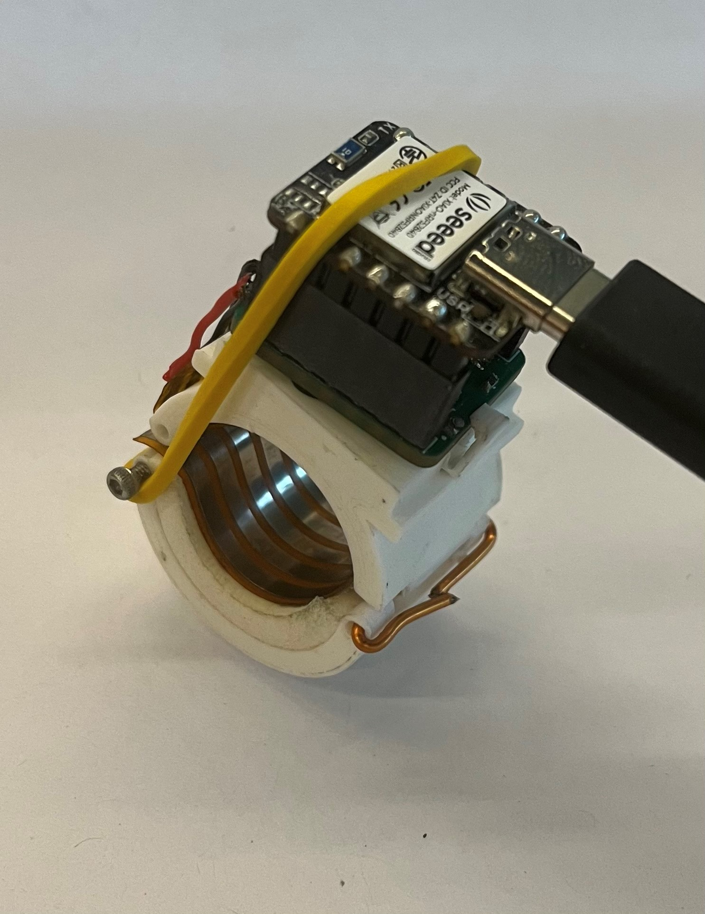
Hardware and Software
Production of the replica
Assembled replica of ElectroRing
Seeed XIAO BLE
Active electrical sensing PCB
Flex PCB
Notes:
Based on the work of kienzle the goal of my semester project was to built a mvp replica of ElectroRing.
I’ve built this replica of the ElectroRing for your research group, that you can furter investigate the potential of this device
On the right side, you can see, how my replica finally looked
On the left side one can see the steps to built a ring and the used hardware parts.
The Ring consists of several parts.
A Seeed XIAO BLE mikrocontroller for measurment of Signal and communication with BLE to a peripheral device
A active electricla sensing PCB, which was the main part of this semesterproject to develop, This is underneath the Seed XIAO BLE
I’ve brougth various iterations of the PCB today, I just give them around and you can take a closer look on your own
Lastly a FleXPCB is connected to the inside of the ring to make galvanical connection to the body
All is holeded together with a 3- Printed Ring wich can be attached to the finger

Slide 8
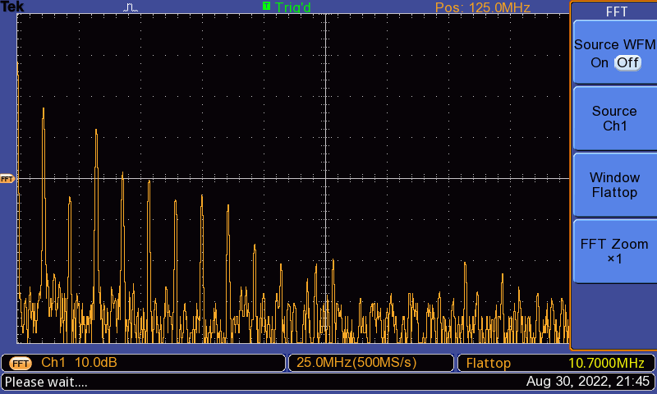
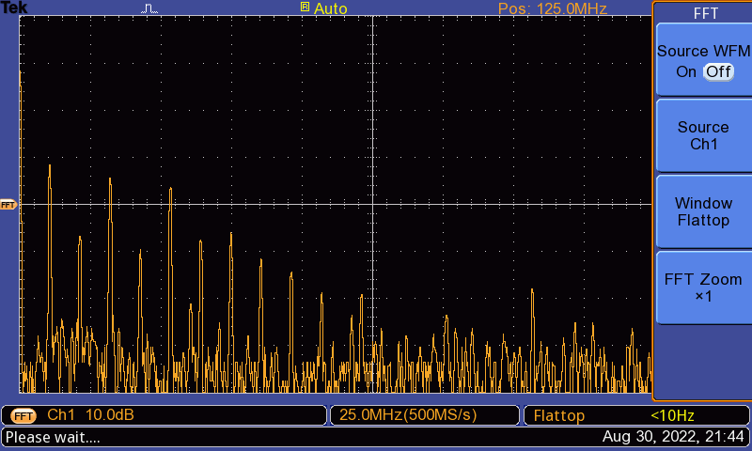
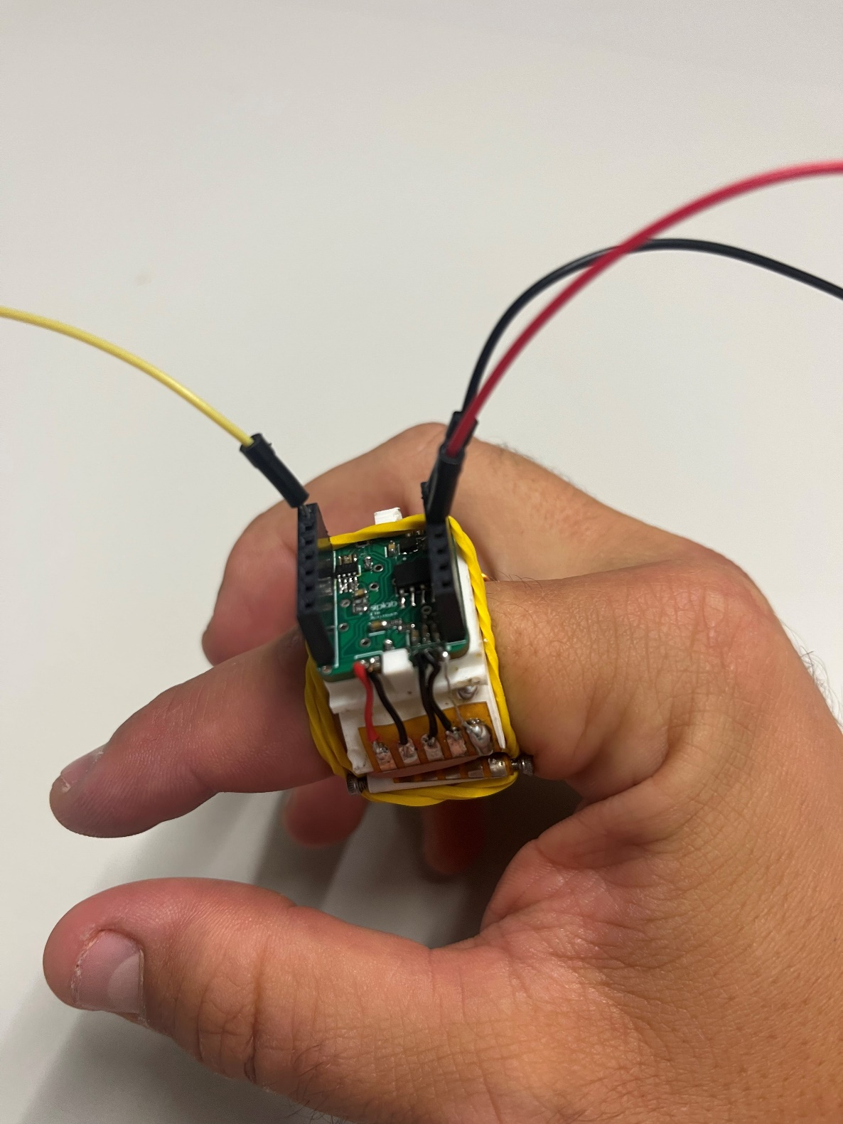





Signal to detect pinch
DFT of no pinch
DFT of pinch
Measurement setup
Notes:
For this slide i hope you are familiar with the Discrete Fourier Transformation, otherwise let me know if someting is unclear
The created active electrical sensing PCB attachet to the ring was connected with an oszilloskop.
With a sampling rate of 500 MS/s the DFT coefficient can be calculated
One sees that the DFT changes in magnitude when pinched
I want to specially point out that the first peak thath rises is corresponding to the operation frequency

Slide 9
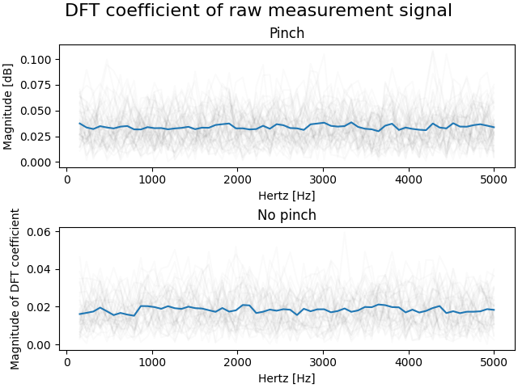
Signal to detect pinch
10 kHz Sampling rate
FFT with 128 samples
No clear frequency which increases during pinching
The touch detection signal is the average of the FFT coefficients except for the first coefficient
Notes:
However the size of the measurment unit to measure the signal was limited and Therfore as already said i used the seed xaio BLE
Which has a maximal sampling rate of 10 kHz and is limited to the 128 samples leading to a much lower resolution.
You can see the reults with the Seeed XIAO in the right image, where the blue line is the average of consecutive calculated DFT coefficents.
It does not behave that well as the oszilloskop but one can see that the hole spectrum rised.
Rather than having one frequency that rised during pinching the hole spectrum rised
It’s worth to mention that the first DFT coefficent is not shwon in the Figure since this one does not change significantly by pinching
For this reason to detect a pinch the average of the DFT coefficents expect the first one was taken. When this average is higher as a certain threshold a pinch can be detected

Slide 10
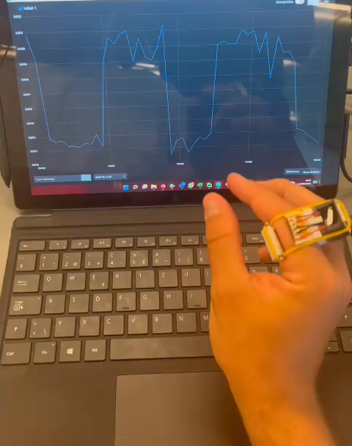

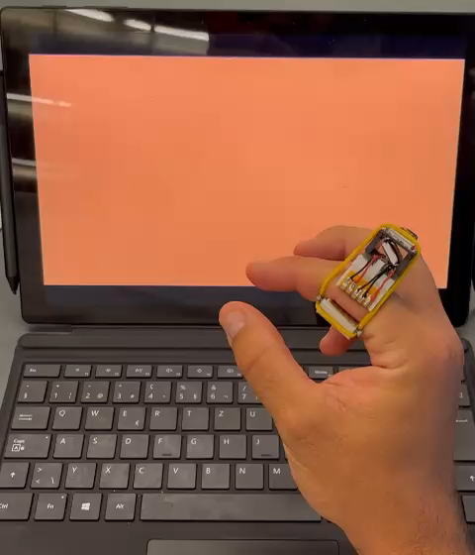



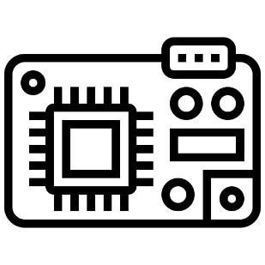


Evaluation
SNR measurement
Latency measurement
Ring sends via BLE pinch to a Seeed XIAO BLE connected to the computer
Ring directly connected to computer
Notes:
To validate the usability of the ring and the robustness of the signal in everyday use, two measurements were carried out: firstly, the signal-to-noise ratio was measured and secondly, the latency. The apparatus to measure each are simplified by the pictograms. For the signal to noise measurement 3 people had to pinch 5 times in a row, afterwards with the mean of a touch event, the mean of a non touch event and the sd of noise (preced of first touch event) the signal to noise was calculated.
For measuring the latency, the ring was powerd by battery, after detected a pinch the ring sends a signal to a second Seeed XIAO BLE connected to the pc, which executes a mous click when receiving a pinch. The hole scene was filmed in slow motion, therefore one can count the frames that passes between finger pinching and computer background change. With the number of the past frames and the FPS the latency can be claculated.

Slide 11
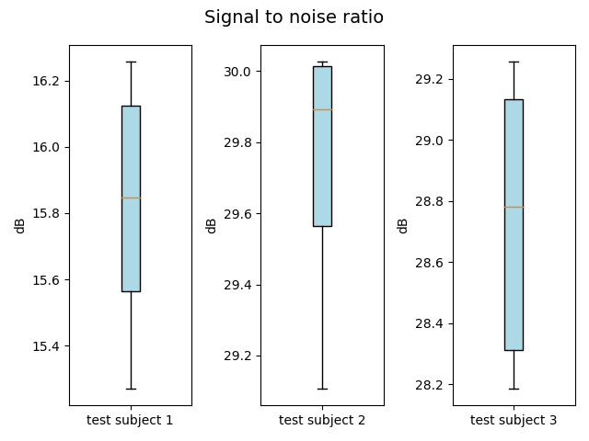

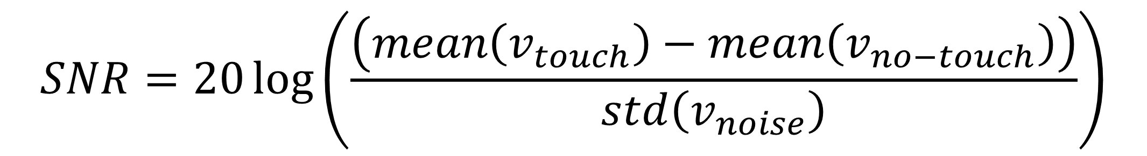
SNR results
$$SNR=20\log\left(\frac{\left(mean\left(v_{touch}\right)−mean\left(v_{no−touch}\right)\right)}{std\left(v_{noise}\right)}\right)$$
$v_{touch}$: samples from a touch segment
$v_{no−touch}$: samples from a non-touch segment
$v_{noise}$: samples from the preceding non-touch segment
Mean = 15.8 dB
(SD = 0.4 ms)
Mean = 29.7 dB
(SD = 0.4 ms)
Mean = 28.7 dB
(SD = 0.5 ms)
Notes:
In this figure you can see the results of the SNR measurement.
The measurements for the SNR were executed by 3 test subjects.
The Range of the mean of the signal to noise ratio starts from 16 db up to 29 db. Futrher one can see that the that the mean for test subject 1 was not as high as the others but it’s totally ok because it’s me and i hoped to convince you today with my demo that it is also working fine.

Slide 12
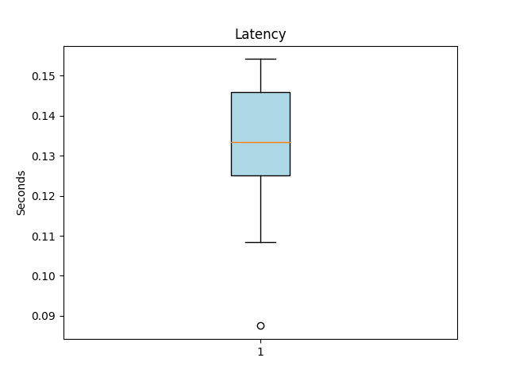
Latency results
Mean = 130 ms (SD = 21 ms)
Notes:
The measured mean of latency is 130 ms, with this latency the replica ring seems rather slowly, but you have to bear in mind thath includs also sending the data via BLE to a second device.

Slide 13
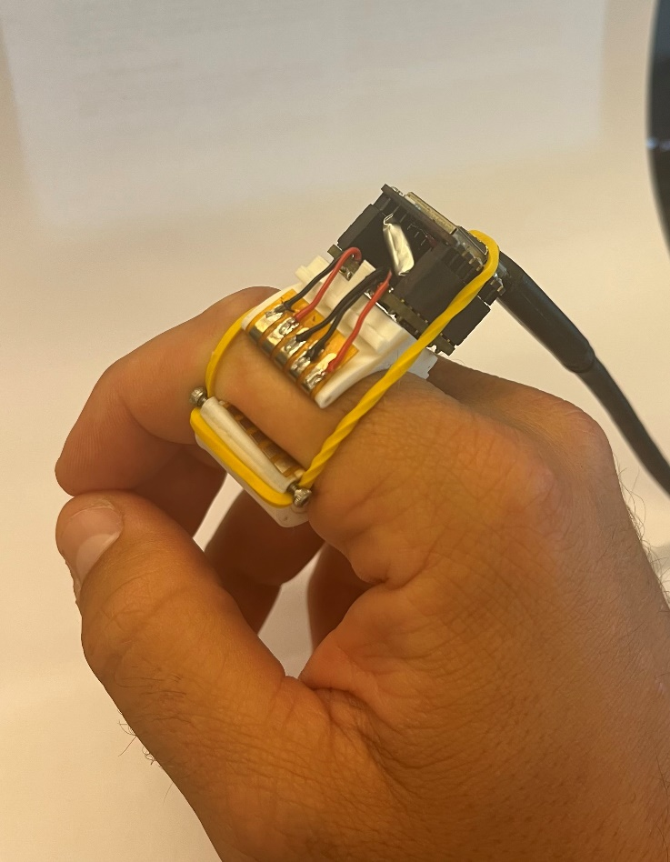
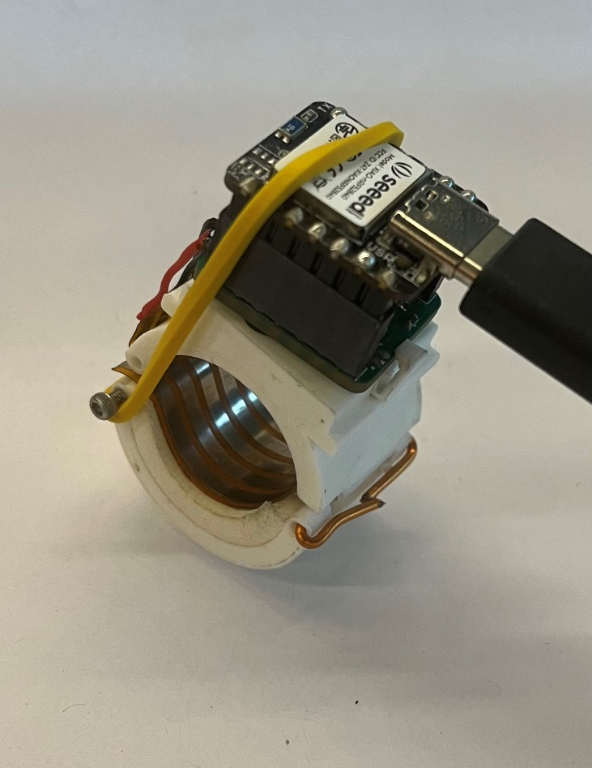
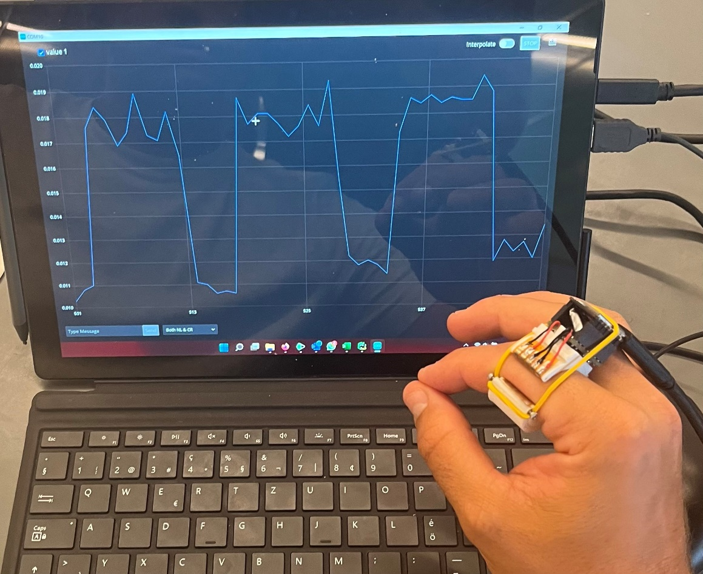
Questions?
Pinch
Notes:
During the semester project, a Working MVP of the electroRing was developed based on the work of Kienzle et al. [1]. It was shown with the evaluation that the SNR and a low latency that the responsiveness of the ring is sufficient to ensure a acceptable human
computer interaction.
Now it’s your turn What do you think about this , how high

Slide 14
Replica vs Original
 | Original | Replica
Operating time | 22 Hours | 40 Minutes
SNR | 25 dB | 25 dB
Latency | 15 ms | 130 ms
Dimension of electronics | 27mm x 17mm x unknown | 22mm x 18 mmx 18mm
Additional | IMU | Vibration motor

Slide 15
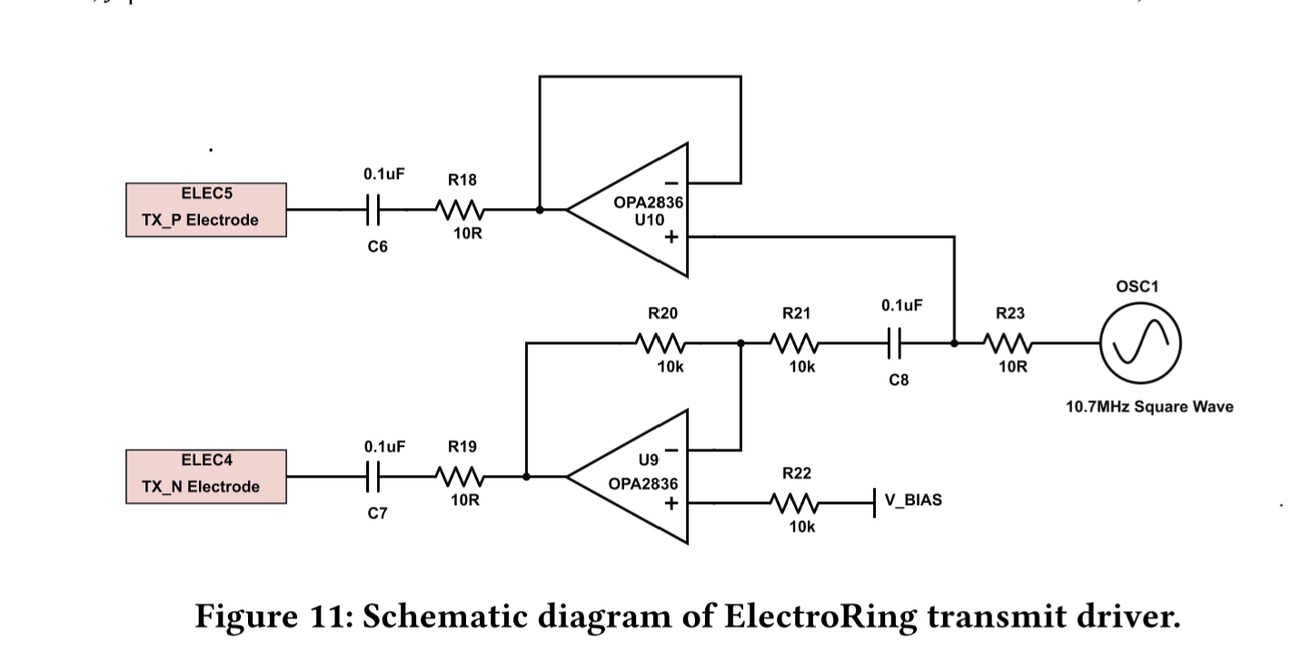
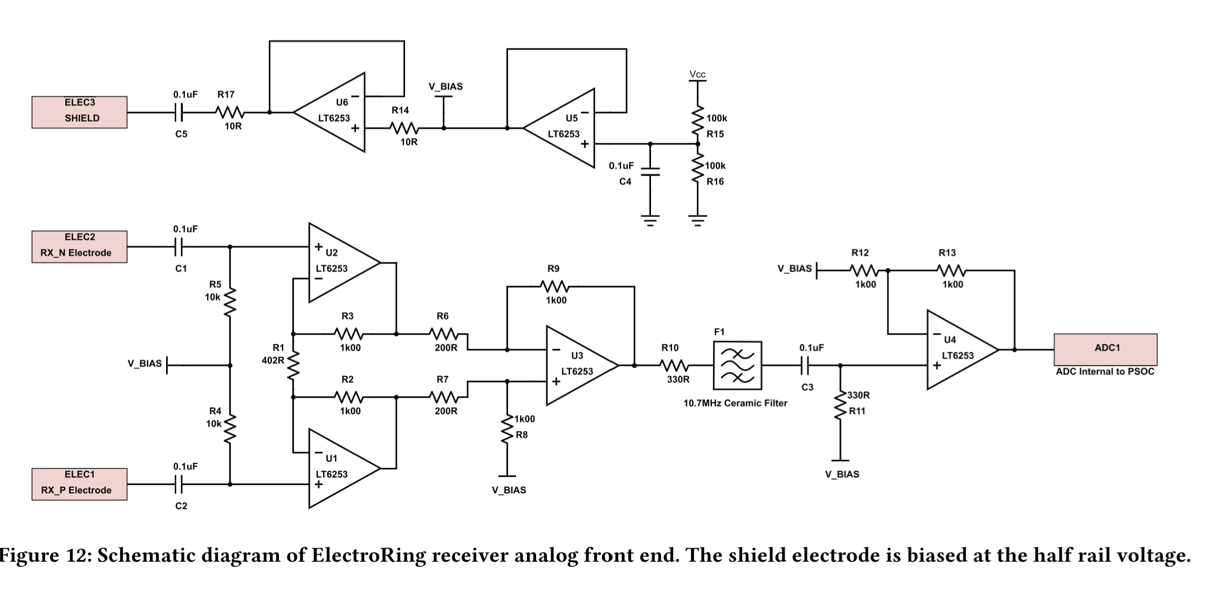
Electrical scheme of AES
ElectroRing
Kienzle et al. CHI’ 21

Slide 16
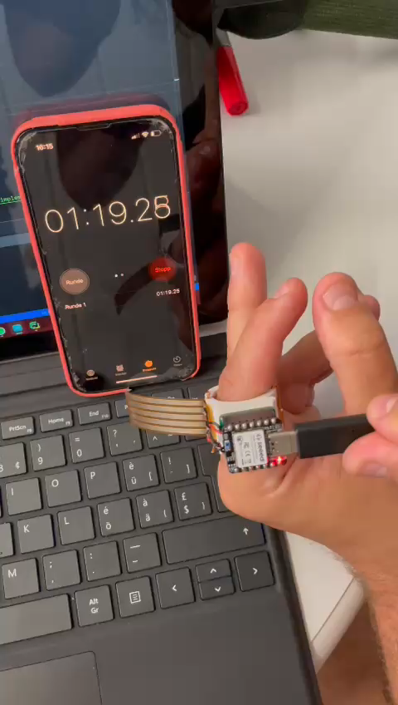
Latency without BLE
Approx: 50 ms
ElectroRing
Kienzle et al. CHI’ 21

